Slide 1
Unit: Cloud Computing Foundations
Based on Mastering Cloud Computing
Rajkumar Buyya et al.

Slide 2
Basics of Parallel Computing
Simultaneous execution of tasks
Improves performance and speed
Used within cloud datacenters

Slide 3
Distributed vs Parallel Computing
Parallel: tightly coupled systems
Distributed: loosely coupled systems
Cloud combines both paradigms

Slide 4
Evolution of Cloud Computing
The idea of renting computing services by leveraging large distributed computing facilities has been around for long time.
It dates back to the days of the mainframes in the early 1950s. From there on, technology has evolved and been refined.
This process has created a series of favorable conditions for the realization of cloud computing.

Slide 5
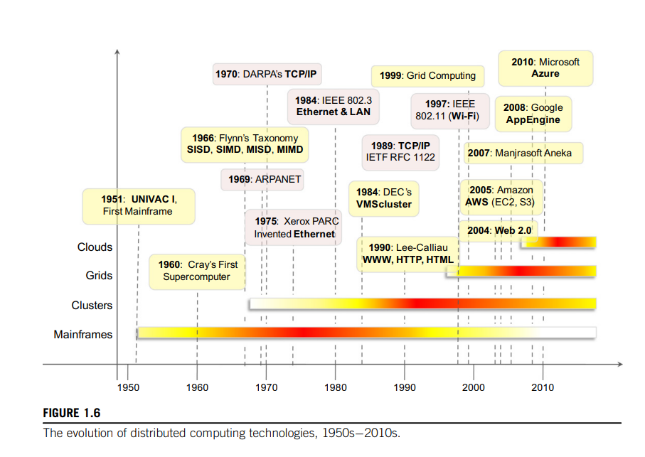

Slide 6
Evolution of Cloud Computing
In tracking the historical evolution, we briefly review five core technologies that played an important role in the realization of cloud computing.
Mainframes
Distributed Systems
Clusters
Grids
Virtualization
Web 2.0
Utility Computing

Slide 7
Mainframes.
These were the first examples of large computational facilities leveraging multiple processing units.
Mainframes were powerful, highly reliable computers specialized for large data movement and massive input/output (I/O) operations.
They were mostly used by large organizations for bulk data processing tasks such as online transactions, enterprise resource planning, and other operations involving the processing of significant amounts of data.
Even though mainframes cannot be considered distributed systems, they offered large computational power by using multiple processors, which were presented as a single entity to users.

Slide 8
One of the most attractive features of mainframes was the ability to be highly reliable computers that were “always on” and capable of tolerating failures transparently.
No system shutdown was required to replace failed components, and the system could work without interruption.
Batch processing was the main application of mainframes. Now their popularity and deployments have reduced, but evolved versions of such systems are still in use for transaction processing (such as online banking, airline ticket booking, supermarket and telcos, and government services).

Slide 9
Clusters.
Cluster computing started as a low-cost alternative to the use of mainframes and supercomputers.
The technology advancement that created faster and more powerful mainframes and supercomputers eventually generated an increased availability of cheap commodity machines as a side effect.
These machines could then be connected by a high-bandwidth network and controlled by specific software tools that manage them as a single system.
Starting in the 1980s, clusters become the standard technology for parallel and high-performance computing.
Built by commodity machines, they were cheaper than mainframes and made high-performance computing available to a large number of groups, including universities and small research labs.

Slide 10
Cluster technology contributed considerably to the evolution of tools and frameworks for distributed computing, including Parallel Virtual Machine (PVM), and Message Passing Interface (MPI)
One of the attractive features of clusters was that the computational power of commodity machines could be leveraged to solve problems that were previously manageable only on expensive supercomputers.
Moreover, clusters could be easily extended if more computational power was required.

Slide 11
Grids
Grid computing appeared in the early 1990s as an evolution of cluster computing.
In an analogy to the power grid, grid computing proposed a new approach to access large computational power, huge storage facilities, and a variety of services.
Users can “consume” resources in the same way as they use other utilities such as power, gas, and water.
Grids initially developed as aggregations of geographically dispersed clusters by means of Internet connections. These clusters belonged to different organizations, and arrangements were made among them to share the computational power.
Different from a “large cluster,” a computing grid was a dynamic aggregation of heterogeneous computing nodes, and its scale was nationwide or even worldwide.

Slide 12
Several developments made possible the diffusion of computing grids:
clusters became quite common resources;
they were often underutilized;
new problems were requiring computational power that went beyond the capability of single clusters;
the improvements in networking and the diffusion of the Internet made possible long-distance, high-bandwidth connectivity.
All these elements led to the development of grids, which now serve a multitude of users across the world.
Cloud computing is often considered the successor of grid computing.

Slide 13
Virtualization
Virtualization is another core technology for cloud computing.
It encompasses a collection of solutions allowing the abstraction of some of the fundamental elements for computing, such as hardware, runtime environments, storage, and networking.
Virtualization has been around for more than 40 years, but its application has always been limited by technologies that did not allow an efficient use of virtualization solutions.
Today these limitations have been substantially overcome, and virtualization has become a fundamental element of cloud computing.

Slide 14
This is particularly true for solutions that provide IT infrastructure on demand.
Virtualization confers that degree of customization and control that makes cloud computing appealing for users and, at the same time, sustainable for cloud services providers.
Virtualization is essentially a technology that allows creation of different computing environments.
These environments are called virtual because they simulate the interface that is expected by a user/guest.

Slide 15
Web 2.0
The Web is the primary interface through which cloud computing delivers its services.
At present, the Web encompasses a set of technologies and services that facilitate interactive information sharing, collaboration, user-centered design, and application composition.
This evolution has transformed the Web into a rich platform for application development and is known as Web 2.0.
This term captures a new way in which developers architect applications and deliver services through the Internet and provides new experience for users of these applications and services.

Slide 16
Web 2.0 brings interactivity and flexibility into Web pages, providing enhanced user experience by gaining Web-based access to all the functions that are normally found in desktop applications.
These capabilities are obtained by integrating a collection of standards and technologies such as XML, Asynchronous JavaScript and XML (AJAX), Web Services, and others.
These technologies allow us to build applications leveraging the contribution of users, who now become providers of content.

Slide 17
Service orientation Computing
Service orientation is the core reference model for cloud computing systems.
This approach adopts the concept of services as the main building blocks of application and system development. Service-oriented computing (SOC) supports the development of rapid, low-cost, flexible, interoperable, and evolvable applications and systems [19].
A service is an abstraction representing a self-describing and platform-agnostic component that can perform any function—anything from a simple function to a complex business process.
Virtually any piece of code that performs a task can be turned into a service and expose its functionalities through a network-accessible protocol. A service is supposed to be loosely coupled, reusable, programming language independent, and location transparent. Loose coupling allows services to serve different scenarios more easily and makes them reusable.

Slide 18
Independence from a specific platform increases services accessibility.
Thus, a wider range of clients, which can look up services in global registries and consume them in a location-transparent manner, can be served.
Services are composed and aggregated into a service-oriented architecture (SOA), which is a logical way of organizing software systems to provide end users or other entities distributed over the network with services through published and discoverable interfaces.
Service-oriented computing introduces and diffuses two important concepts, which are also fundamental to cloud computing: quality of service (QoS) and Software-as-a-Service (SaaS).

Slide 19
Utility-oriented computing
Utility computing is a vision of computing that defines a service-provisioning model for compute services in which resources such as storage, compute power, applications, and infrastructure are packaged and offered on a pay-per-use basis.
The idea of providing computing as a utility like natural gas, water, power, and telephone connection has a long history but has become a reality today with the advent of cloud computing.
Among the earliest forerunners of this vision we can include the American scientist John McCarthy, who, in a speech for the Massachusetts Institute of Technology (MIT) centennial in 1961, observed:
“If computers of the kind I have advocated become the computers of the future, then computing may someday be organized as a public utility, just as the telephone system is a public utility ... The computer utility could become the basis of a new and important industry.”

Slide 20
The first traces of this service-provisioning model can be found in the mainframe era. IBM and other mainframe providers offered mainframe power to organizations such as banks and government agencies throughout their datacenters.
The idea of computing as utility remained and extended from the business domain to academia with the advent of cluster computing.
The capillary diffusion of the Internet and the Web provided the technological means to realize utility computing on a worldwide scale and through simple interfaces.
As already discussed, computing grids provided a planet-scale distributed computing infrastructure that was accessible on demand. Computing grids brought the concept of utility computing to a new level: market orientation

Slide 21
From an application and system development perspective, service-oriented computing and service-oriented architectures (SOAs) introduced the idea of leveraging external services for performing a specific task within a software system.
All these factors contributed to the development of the concept of utility computing and offered important steps in the realization of cloud computing, in which the vision of computing utilities comes to its full expression.

Slide 22
Characteristics of Cloud Computing
On-demand self-service
Broad network access
Resource pooling
Rapid elasticity
Measured service

Slide 23
Benefits of Cloud Computing
No capital expenditure
Reduced maintenance cost
Scalability and flexibility
Global accessibility

Slide 24
Benefits of Cloud Computing
The most evident benefit from the use of cloud computing systems and technologies is the increased economical return due to the reduced maintenance costs and operational costs related to IT software and infrastructure.
This is mainly because IT assets, namely software and infrastructure, are turned into utility costs, which are paid for as long as they are used, not paid for up front.
Cloud computing transforms IT infrastructure and software into utilities, thus significantly contributing to increasing efficiency and reducing upfront investment.

Slide 25
Cloud computing also provides an opportunity for small organizations and start-ups: these do not need large investments to start their business, but they can comfortably grow with it.
Finally, maintenance costs are significantly reduced: by renting the infrastructure and application services, organizations are no longer responsible for their maintenance.

Slide 26
Increased agility in defining and structuring software systems is another significant benefit of cloud computing.
Since organizations rent IT services, they can more dynamically and flexibly compose their software systems, without being constrained by capital costs for IT assets.

Slide 27
There is a reduced need for capacity planning, since cloud computing allows organizations to react to unplanned surges in demand quite rapidly.
For example, organizations can add more servers to process workload spikes and dismiss them when they are no longer needed.

Slide 28
Ease of scalability is another advantage.
By leveraging the potentially huge capacity of cloud computing, organizations can extend their IT capability more easily.
Scalability can be leveraged across the entire computing stack.
Infrastructure providers offer simple methods to provision customized hardware and integrate it into existing systems.
Platform-as-a-Service providers offer runtime environment and programming models that are designed to scale applications.
Software-as-a-Service offerings can be elastically sized on demand without requiring users to provision hardware or to program application for scalability.

Slide 29
End users can benefit from cloud computing by having their data and the capability of operating on it always available, from anywhere, at any time, and through multiple devices.
Information and services stored in the cloud are exposed to users by Web-based interfaces that make them accessible from portable devices as well as desktops at home.
Since the processing capabilities (that is, office automation features, photo editing, information management, and so on) also reside in the cloud, end users can perform the same tasks that previously were carried out through considerable software investments.
The cost for such opportunities is generally very limited, since the cloud service provider shares its costs across all the tenants that he is servicing.

Slide 30
Multitenancy allows for better utilization of the shared infrastructure that is kept operational and fully active.
The concentration of IT infrastructure and services into large datacenters also provides opportunity for considerable optimization in terms of resource allocation and energy efficiency, which eventually can lead to a less impacting approach on the environment.

Slide 31
Service orientation and on-demand access create new opportunities for composing systems and applications with a flexibility not possible before cloud computing.
New service offerings can be created by aggregating together existing services and concentrating on added value.
Since it is possible to provision on demand any component of the computing stack, it is easier to turn ideas into products with limited costs and by concentrating technical efforts on what matters: the added value.

Slide 32
Limitations of Cloud Computing
Security and privacy concerns
Vendor lock-in
Internet dependency
Legal issues

Slide 33
Cloud vs Traditional Computing
Traditional: Fixed infrastructure
Cloud: Pay-per-use
Elastic and scalable resources

Slide 34
Cloud Adoption Challenges
Security and trust
Compliance and regulations
Interoperability
Performance unpredictability

Slide 35
Cloud Adoption Challenges
As any new technology develops and becomes popular, new issues have to be faced. Cloud computing is not an exception.
New, interesting problems and challenges are regularly being posed to the cloud community, including IT practitioners, managers, governments, and regulators.

Slide 36
Besides the practical aspects, which are related to configuration, networking, and sizing of cloud computing systems, a new set of challenges concerning the dynamic provisioning of cloud computing services and resources arises.
For example, in the Infrastructure-as-a-Service domain, how many resources need to be provisioned, and for how long should they be used, in order to maximize the benefit?
Technical challenges also arise for cloud service providers for the management of large computing infrastructures and the use of virtualization technologies on top of them.
In addition, issues and challenges concerning the integration of real and virtual infrastructure need to be taken into account from different perspectives, such as security and legislation.

Slide 37
Security in terms of confidentiality, secrecy, and protection of data in a cloud environment is another important challenge.
Organizations do not own the infrastructure they use to process data and store information.
This condition poses challenges for confidential data, which organizations cannot afford to reveal. Therefore, assurance on the confidentiality of data and compliance to security standards, which give a minimum guarantee on the treatment of information on cloud computing systems, are sought.
The problem is not as evident as it seems: even though cryptography can help secure the transit of data from the private premises to the cloud infrastructure, in order to be processed the information needs to be decrypted in memory.
This is the weak point of the chain: since virtualization allows capturing almost transparently the memory pages of an instance, these data could easily be obtained by a malicious provider.

Slide 38
Legal issues may also arise. These are specifically tied to the ubiquitous nature of cloud computing, which spreads computing infrastructure across diverse geographical locations.
Different legislation about privacy in different countries may potentially create disputes as to the rights that third parties (including government agencies) have to your data.
U.S. legislation is known to give extreme powers to government agencies to acquire confidential data when there is the suspicion of operations leading to a threat to national security.
European countries are more restrictive and protect the right of privacy. An interesting scenario comes up when a U.S. organization uses cloud services that store their data in Europe. In this case, should this organization be suspected by the government, it would become difficult or even impossible for the U.S. government to take control of the data stored in a cloud datacenter located in Europe.

Slide 39
Applications of Cloud Computing
Scientific computing
Business applications
Consumer services
Emerging technologies

Slide 40
Conclusion
Cloud computing delivers IT as a utility
Efficient, scalable, and cost-effective model

